Slide 1
Introducing Google Firebase: A Free Database for Your Mobile Apps
Presented by Kimberly Hermans

Slide 2
Prerequisites for this Presentation
Skills
Familiarity with Android Studio
Proficiency in Java
Materials
Computer
A Google account
Android Studio
Android device or emulator

Slide 3
Learning Objectives
By the end of this presentation, you will be able to:
Understand Firebase capabilities and limitations
Connect Firebase to your Android App
Set up a Realtime Database
Understand database structure
Add to your database
Read from your database
Update an object from your database
Remove an object from your database

Slide 4
What is Firebase? Is it for me?
Firebase is a comprehensive mobile development platform with many useful features
Ex. Analytics, Hosting, Authentication, Realtime Databases
Realtime Database is designed to update all connected devices in realtime
Stores data in a JSON (Javascript Object Notation) format
Limitations: Difficult to sort and search large amounts of data
Larger scale data consider Cloud Firestore (still in Beta)

Slide 5
What is a No-SQL Database?
A SQL Database is a database where everything is stored as a table with a set of fields
A No-SQL Database allows you to store anything you want to the database without following a specific format
JSON (JavaScript Object Notation) allows you to define fields for each individual object
Firebase is a No-SQL database that stores objects in a JSON format

Slide 6
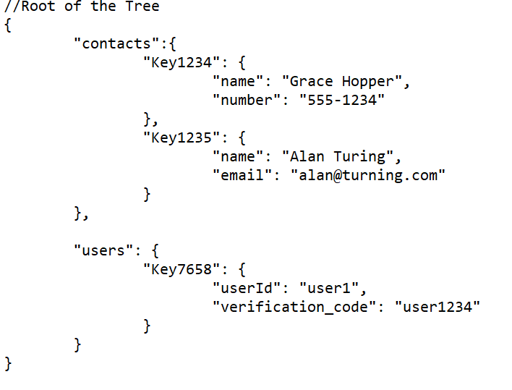
Database Structure
Data is stored in a JSON Structure
Stores objects
ID needs to be unique at each level
Consider your database design before you begin
For login/authentication, consider using the Firebase Authentication feature (not covered here)

Slide 7
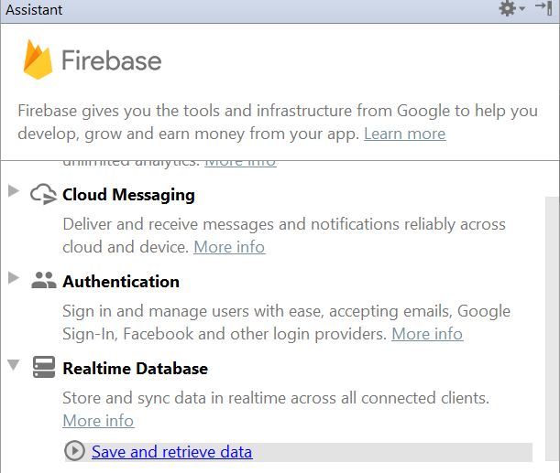
Connecting Firebase
To use the Assistant Window, you will need Google Repository v26 or higher downloaded in Android Studio
Tools>SDK Manager, SDK Tools tab, Google Repository checkbox, OK to install
From Android Studio: Tools>Firebase
Expand “Realtime Database”

Slide 8
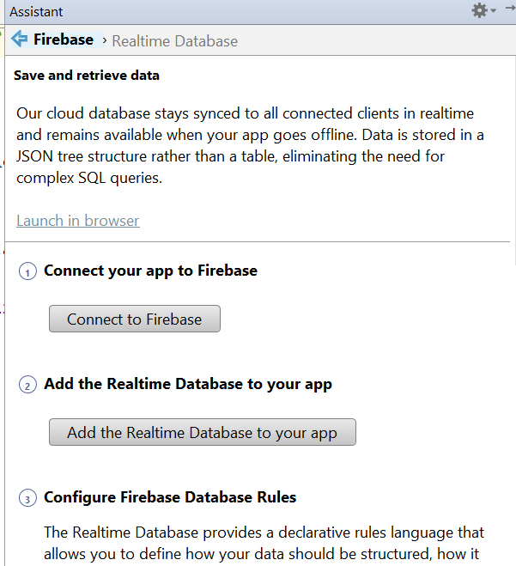
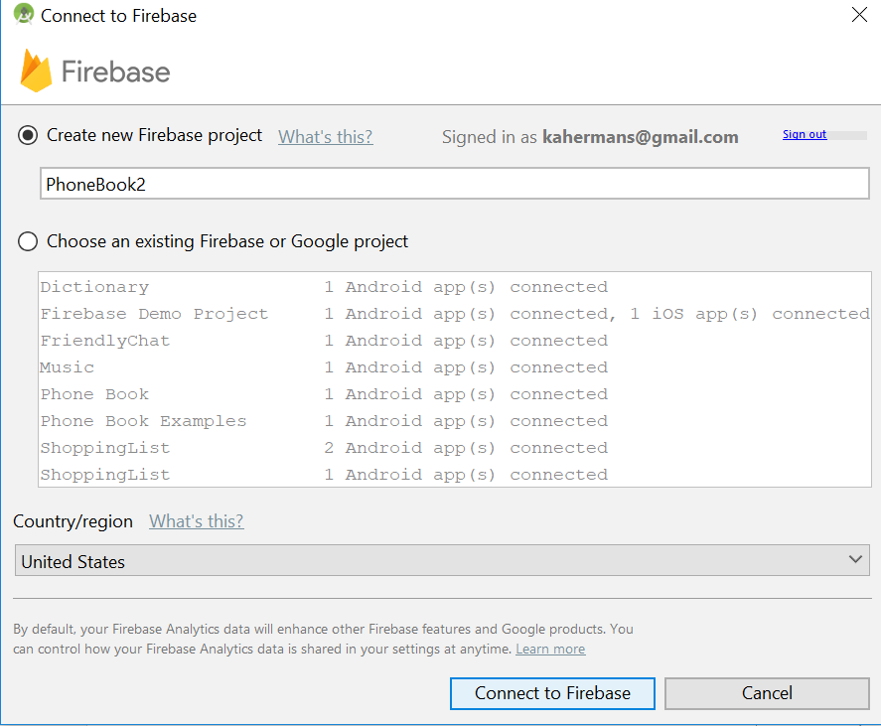
Connecting A Realtime Database

Slide 9
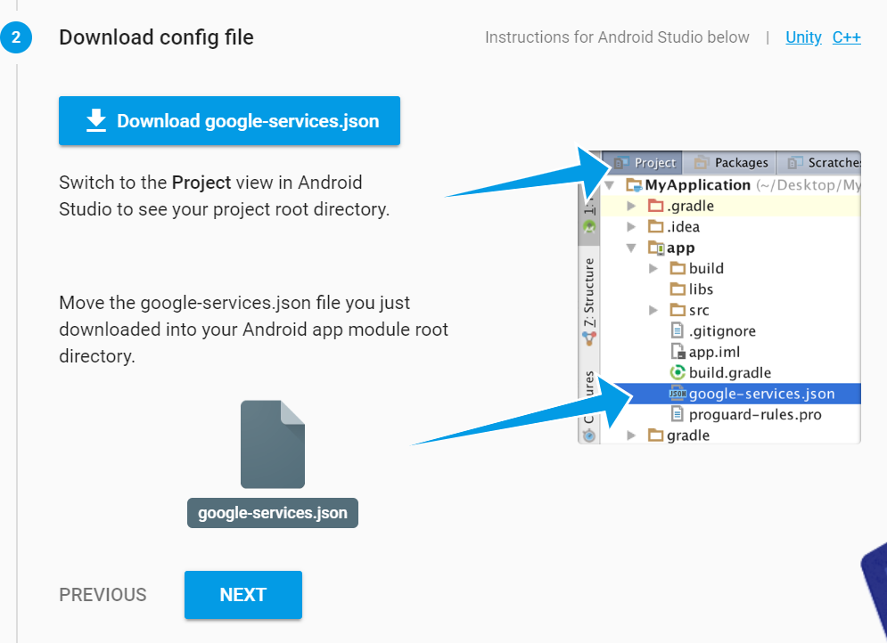
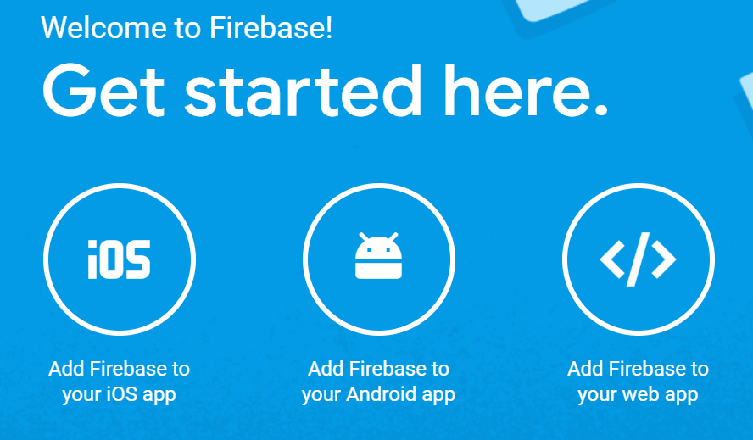
Connecting Through Firebase Console (alternative process)
Login to Firebase
Select your project
Download google-services.json and copy to your “app” root folder

Slide 10
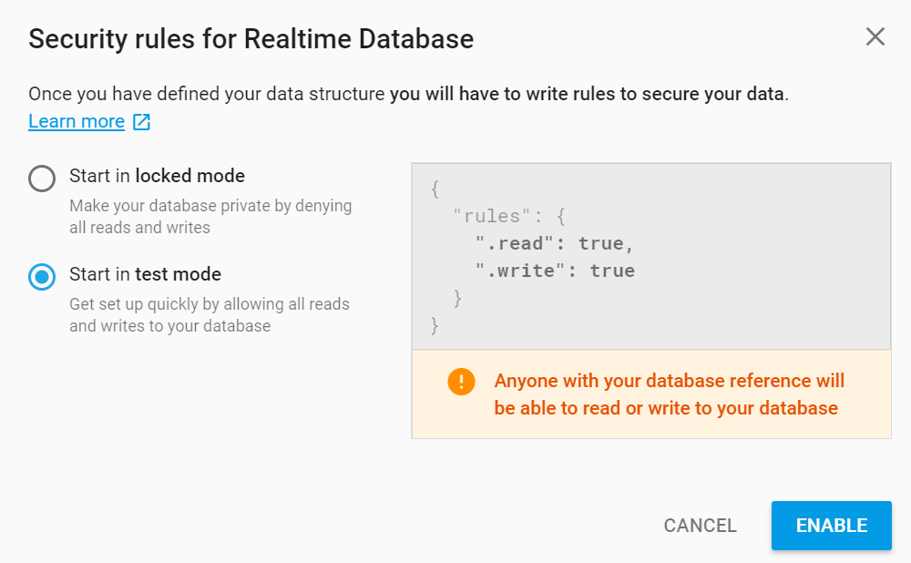
Test Mode
Database>Realtime Database
Select test mode
To change permissions, edit under “rules”

Slide 11
Example Activity: Developing a Simple Phonebook
.XML and .java files can be found at https://github.com/kahermans/PhoneBookDemo.git
Each operation is a separate activity
Contact Object stores the name and number of a Contact (note: you must define a no-args constructor)
You will need to include the contact_view.xml for the ContactAdapter to work
ContactAdapter is a custom adapter that will handle the Contacts in the ListViews

Slide 12
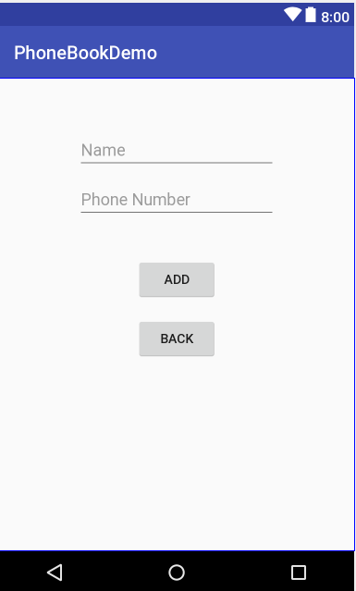
Adding Activity Demonstration
editTextName
editTextNumber
buttonAdd
buttonHome
Don’t forget to direct the button to a function in your .java file

Slide 13
Adding Activity Demonstration
public class AddActivity extends AppCompatActivity { @Override protected void onCreate(Bundle savedInstanceState) { super.onCreate(savedInstanceState); setContentView(R.layout.activity_add); }
}
Notes:
This code is automatically generated when an activity is created.

Slide 14
Adding Activity Demonstration – Declaring and Initializing Variables for Database Access
public class AddActivity extends AppCompatActivity {
private DatabaseReference myRef; private FirebaseDatabase database; @Override protected void onCreate(Bundle savedInstanceState) { super.onCreate(savedInstanceState); setContentView(R.layout.activity_add);
database = FirebaseDatabase.getInstance(); myRef = database.getReference("contacts"); }
}
Notes:
Declare variables that will store an instance and reference to your database
Initialize variables to the current instance of the database, with a reference to the children of “contacts”

Slide 15
Adding Activity Demonstration – Adding a New Entry to the Database
public void addContact(View view) { EditText editName = findViewById(R.id.editTextName); String name = editName.getText().toString(); EditText editNumber = findViewById(R.id.editTextPhone); String phone = editNumber.getText().toString(); if( name.length() > 0 ) { Contact c = new Contact(name, phone); myRef.child(myRef.push().getKey()).setValue(c); Toast.makeText(this, c.getName() + " successfully added.", Toast.LENGTH_LONG).show(); } editName.setText(""); editNumber.setText(""); }
Notes:
We want each child to have a unique key, so multiple entries can be stored that may have the same values. By using the .push().getKey() function, we can generate a unique key to assign our new record. We will then set the value at that key to the new Contact object we have created.

Slide 16
Adding Activity Demonstration – Programming the Home Button
public void goHome( View view ) { Intent intent = new Intent(this, MainActivity.class); startActivity( intent); }
Notes:
We need to program the Home button, so we will load the MainActivity

Slide 17
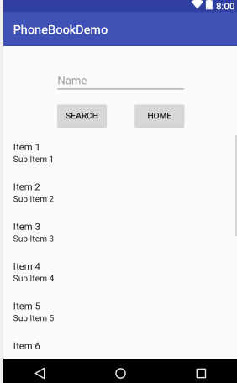
Search Activity Demonstration
editTextName
buttonSearch
buttonHome
listViewResults

Slide 18
Search Activity Demonstration
public class SearchActivity extends AppCompatActivity
{ @Override protected void onCreate(Bundle savedInstanceState) { super.onCreate(savedInstanceState); setContentView(R.layout.activity_search);
}
}
Notes:
This code is automatically generated when an activity is created.

Slide 19
Search Activity Demonstration – Declare Variables
public class SearchActivity extends AppCompatActivity { private FirebaseDatabase database; private DatabaseReference myRef; private ChildEventListener childEventListener; private ArrayList<Contact> contactList;
private ArrayList<Contact> searchResults;
private ContactAdapter listAdapter; @Override protected void onCreate(Bundle savedInstanceState) { super.onCreate(savedInstanceState); setContentView(R.layout.activity_search);
}
}
Notes:
In addition to having to declare our variable that will allow us to access the database, we will also need to add a ChildEventListener that will allow us to read the database. We will need a local data structure that will store the information that we have read from the database. We will also need an ArrayAdapter that will help us to add content to a list for viewing in the app. Be sure that you have defined an XML file for the ArrayAdapter

Slide 20
Search Activity Demonstration – Initialize Instance Variables
protected void onCreate(Bundle savedInstanceState) { super.onCreate(savedInstanceState); setContentView(R.layout.activity_search); database = FirebaseDatabase.getInstance(); myRef = database.getReference("contacts"); contactList = new ArrayList<Contact>(); searchResults = new ArrayList<Contact>(); …
}
Notes:
Initialize the local data structure so we can add to it when we read the data from the database. We will also need to set up an ArrayAdapter to properly display our list of results in the app. To set up the ArrayAdapter, we will need an XML file (mine is called list_view.XML) and an ArrayList of Strings. We will use the XML and the empty ArrayList of strings to set up the ArrayAdapter. We will add to the ArrayAdapter when we have a list of results.

Slide 21
Search Activity Demonstration – Set up ChildEventListener
childEventListener = new ChildEventListener(){ @Override public void onChildAdded(DataSnapshot dataSnapshot, String s) {} @Override public void onChildChanged(DataSnapshot dataSnapshot, String s) {} @Override public void onChildRemoved(DataSnapshot dataSnapshot) {} @Override public void onChildMoved(DataSnapshot dataSnapshot, String s) {} @Override public void onCancelled(DatabaseError databaseError) {} };
Notes:
A ChildEventListener needs to be added to the reference of the database in the onCreate function. You will define your own ChildEventListener, and you must implement 5 methods. The method can be left blank if you do not want anything done.

Slide 22
Search Activity Demonstration – Copy Children to a Local Data Structure
childEventListener = new ChildEventListener(){ @Override public void onChildAdded(DataSnapshot dataSnapshot, String s)
{ contactList.add(dataSnapshot.getValue(Contact.class)); }
…
};
Notes:
We will define onChildAdded only. Don’t let the name fool you, this will read all the current children when the ChildEventListener is added and any other children added thereafter.

Slide 23
Search Activity Demonstration – Add ChildEventListener to the Database
protected void onCreate(Bundle savedInstanceState) { super.onCreate(savedInstanceState); … childEventListener = new ChildEventListener(){ … }; myRef.addChildEventListener(childEventListener); listAdapter = new ContactAdapter( this, searchResults); ListView results = findViewById(R.id.listViewResults); results.setAdapter(listAdapter);
}
Notes:
You must add the ChildEventListener to the database. You want to be as low down in the hierarchy as possible, as listening to every record from the root can be “expensive” on resources

Slide 24
Search Activity Demonstration – Set up ContactAdapter and ListView
protected void onCreate(Bundle savedInstanceState) { super.onCreate(savedInstanceState); … childEventListener = new ChildEventListener(){ … }; myRef.addChildEventListener(childEventListener); listAdapter = new ContactAdapter( this, searchResults); ListView results = findViewById(R.id.listViewResults); results.setAdapter(listAdapter); }
Notes:
We will now associate the ArrayAdapter we previously set up with the ListView

Slide 25
Search Activity Demonstration – Search Local Data Structure
public void search(View view)
{ listAdapter.clear(); boolean found = false; for( Contact c: contactList) { EditText text = (EditText)findViewById(R.id.editTextName); String search = text.getText().toString(); if(c.getName().equalsIgnoreCase(search)) { listAdapter.add(c); found = true; } }
… }
Notes:
We will now program the button “Search”. We will clear the listAdapter, so it will only display the results from the current search. We will iterate through the local data structure to find all children that match the search criteria. If a child matches the search criteria we will add that child to the listAdapter, which is essentially an ArrayList of Strings that will be displayed in the app.

Slide 26
Search Activity Demonstration – Search the Local Data Structure for Results
public void search(View view)
{
…
EditText search = (EditText)findViewById(R.id.editTextName); if(!found) { Toast.makeText(this, search.getText().toString() + " not found.", Toast.LENGTH_LONG).show(); } search.setText(""); }
Notes:
For the scenario where the search criteria is not found, we will have a message pop up that tells our user that they had no search results. We will also reset the text after the search.

Slide 27
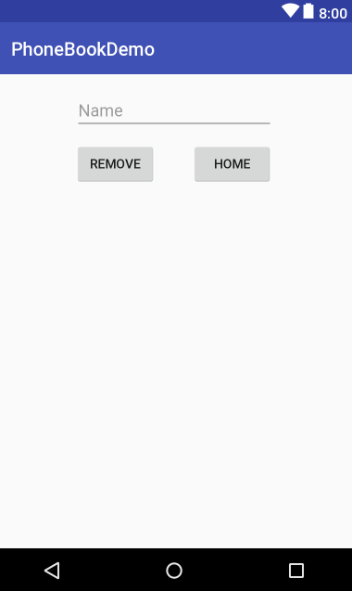
Remove Activity Demonstration
editTextName
buttonRemove
buttonHome
listViewResults

Slide 28
Remove Activity Demonstration
protected void onCreate(Bundle savedInstanceState) { … results.setOnItemClickListener(new AdapterView.OnItemClickListener() { @Override public void onItemClick(AdapterView<?> parent, View view, int position, long id) { Contact selectedItem = (Contact) parent.getItemAtPosition(position); myRef.child(selectedItem.getUid()).removeValue(); contactList.remove(selectedItem); refresh(selectedItem.getName()); } }
Notes:
The code for onCreate is identical to SearchActivity, with the exception of setting up an ArrayAdapter. We will define a remove record which searches the local data structure searching for the name to remove. In this design, all records that match the name will be removed. We will reference the contact by the unique id generated when the contact was added. You can delete individual records, but for the simplicity of this demonstration, we will delete all of them.

Slide 29
Remove Activity Demonstration: Refresh
public void refresh(String update) { listAdapter.clear();
for (Contact c : contactList) { if (c.getName().equalsIgnoreCase(update)) { listAdapter.add(c); } } }
Notes:
The code for onCreate is identical to SearchActivity, with the exception of setting up an ArrayAdapter. We will define a remove record which searches the local data structure searching for the name to remove. In this design, all records that match the name will be removed. We will reference the contact by the unique id generated when the contact was added. You can delete individual records, but for the simplicity of this demonstration, we will delete all of them.

Slide 30
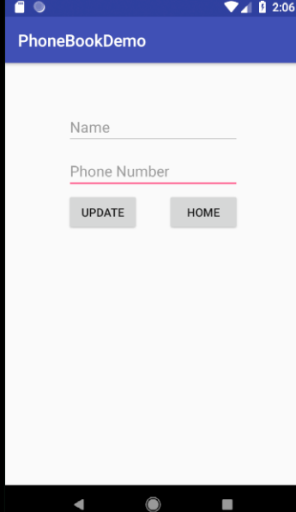
Update Activity Demonstration
editTextName
editTextNumber
buttonHome
buttonUpdate
listViewResults

Slide 31
Update activity Demonstration
public void onCreate(Bundle savedInstanceState) {
… results.setOnItemClickListener(new AdapterView.OnItemClickListener() { @Override public void onItemClick(AdapterView<?> parent, View view, int position, long id) { Contact selectedItem = (Contact) parent.getItemAtPosition(position); EditText name = (EditText) findViewById( R.id.editTextName); EditText phone = (EditText) findViewById(R.id.editTextPhone); String updatePhone = phone.getText().toString(); TextView instructions = (TextView)findViewById(R.id.textViewInstructions); …
});
}
Notes:
In order to update a record, you will need to know the ID of the record, and set the value to the updated version. You will overwrite what is currently there. We need to access the Contact uid which will find the correct record.

Slide 32
Update activity Demonstration
public void onCreate(Bundle savedInstanceState) {
…
public void onItemClick(AdapterView<?> parent, View view, int position, long id) { … if(!updatePhone.equals("")) { Contact add = new Contact(selectedItem.getName(), updatePhone, selectedItem.getUid()); myRef.child(selectedItem.getUid()).setValue(add); instructions.setText(add.getName() + " successfully updated."); contactList.remove( selectedItem ); contactList.add( add ); refresh( add.getName()); } … } });
}
Notes:
In order to update a record, you will need to know the ID of the record, and set the value to the updated version. You will overwrite what is currently there. We need to access the Contact uid which will find the correct record.

Slide 33
Update activity Demonstration
public void onCreate(Bundle savedInstanceState) {
…
results.setOnItemClickListener(new AdapterView.OnItemClickListener() { @Override public void onItemClick(AdapterView<?> parent, View view, int position, long id) { … if(!updatePhone.equals("")) { …
} else instructions.setText("Invalid phone number, please try again."); name.setText(""); phone.setText(""); } });
}
Notes:
In order to update a record, you will need to know the ID of the record, and set the value to the updated version. You will overwrite what is currently there. We need to access the Contact uid which will find the correct record.

Slide 34
References
Follow me on Twitter @misshermans
Github Resources: https://github.com/kahermans/PhoneBookDemo.git
Google Firebase Guides: https://firebase.google.com/docs/android/
Custom Adapter: https://medium.com/mindorks/custom-array-adapters-made-easy-b6c4930560dd

